Slide 1
Glaciology, Race, and Masculinity
Contributors: Seth Olinger
Keywords: glaciology, masculinity, feminism, Indigenous peoples, scientific racism
Location: United States, global
People: Louis Agassiz, Jan Carstenszoon
Last updated: December 6, 2020
Visit https://geo-context.github.io for the teacher’s companion guide to these slides.

Slide 2
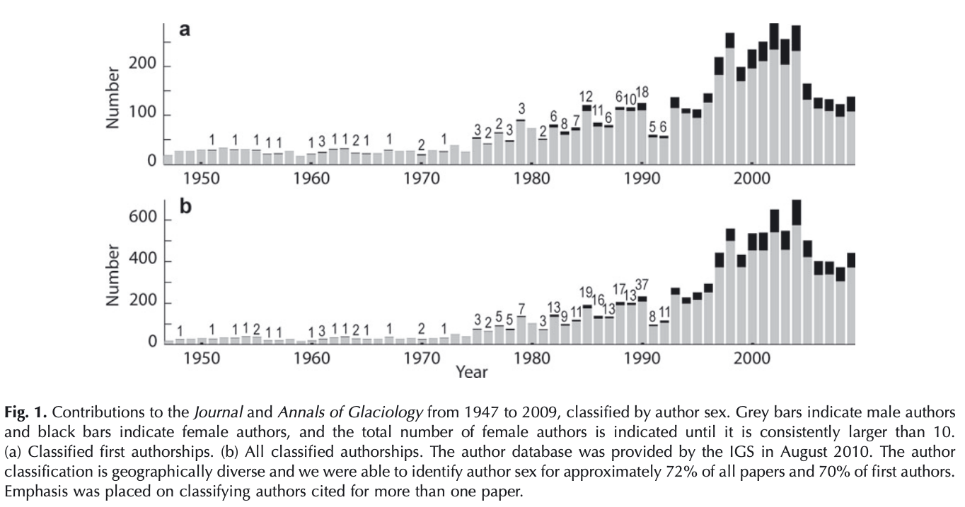
Glaciology is a male-dominated field
In 2009, <20% of authors in Journal of Glaciology & Annals of Glaciology were women.¹
Number of female first authorships
Why?
1985: first year in which over 10 papers were first-authored by women
Number of total female authorships
Reproduced from Hulbe et al, 2010
Notes:
¹Women in Glaciology, a Historical Perspective (Hulbe et al 2010)

Slide 3
Female exclusion in glaciology
Inception of the university system excluded women: The development of Western science was masculine by design.
Contributions by women were largely ignored: In the 1800s, expeditions into the field were led by men, and the emerging field of glaciology was developed by those men. Women regularly attended such expeditions, making observations and collecting data, but were remembered as wives of an expedition’s male members and not as scientists in their own right.¹
Academic skill is conflated with outdoorsmanship: Outdoors experience, considered a prerequisite to glaciology, is more common among men than women² and requires financial means, presenting a barrier-to-entry for potential scientists. Even today, media coverage and conversations within glaciology often focus on tales of difficult field work and extra-academic adventures.³
In 2009, <20% of authors in Journal of Glaciology & Annals of Glaciology were women.¹
1100s
1660
1920
1945
University of
Oxford founded
Royal Society of London founded
Women made eligible for
full admission at Oxford
First female members elected to Royal Society
Notes:
¹Women in Glaciology, a Historical Perspective (Hulbe et al 2010)
²For more info on gender and the outdoors, REI provides a decent place to start: https://www.rei.com/blog/hike/closing-gender-gap-great-outdoors
³Glaciers, gender, and science: A feminist glaciology framework for global environmental change research (Carey et al 2016)

Slide 4
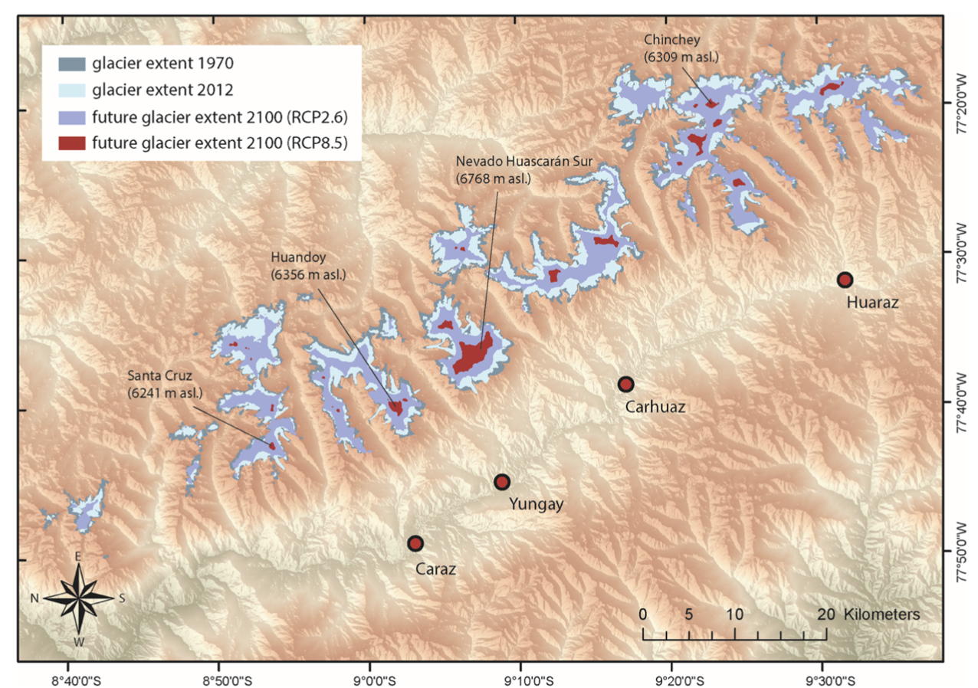
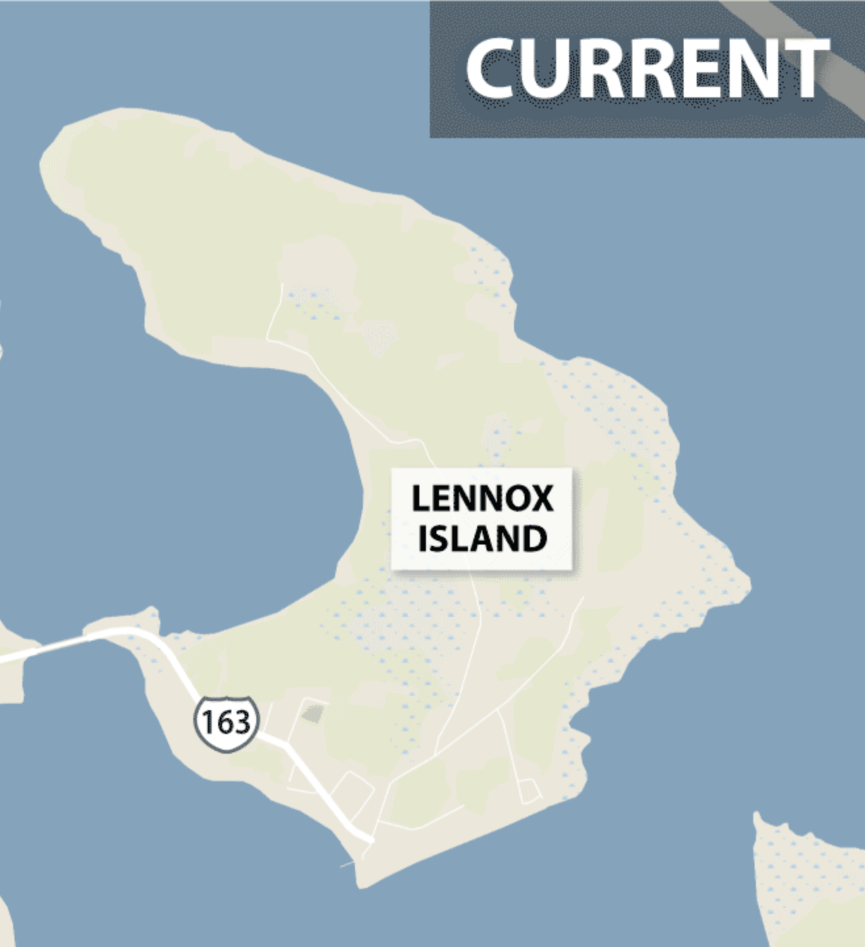
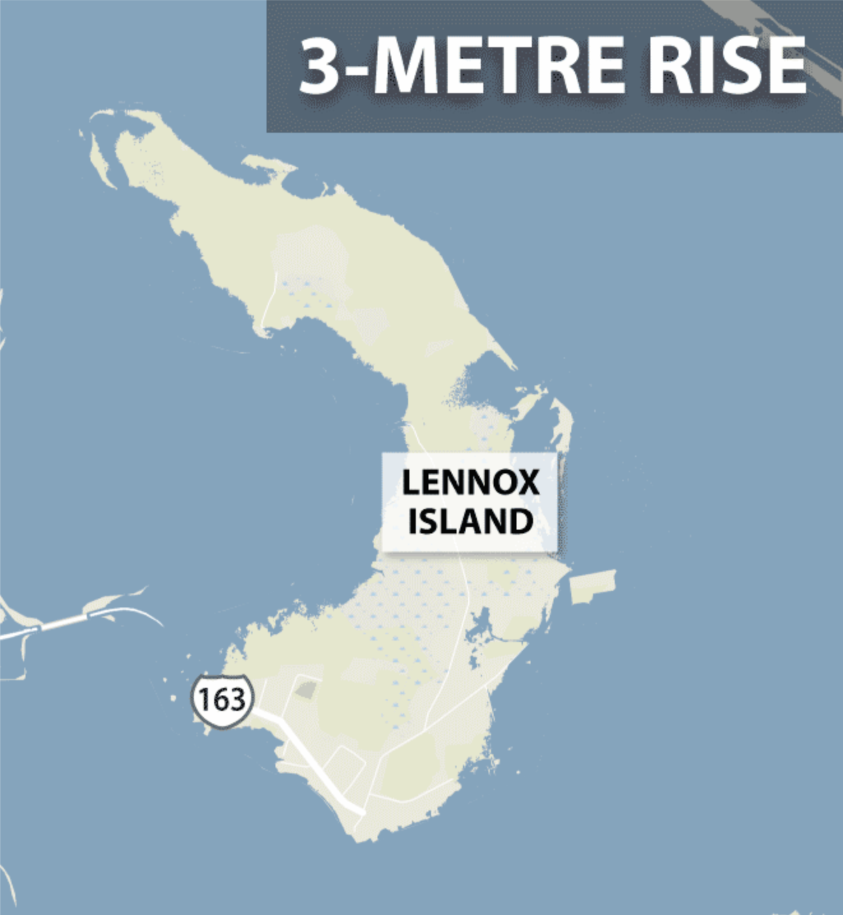
Glacial Hazards and Indigenous Peoples
Indigenous peoples are disproportionately affected by glaciers and ice sheets.
Water scarcity: People living in glaciated regions rely on annual snowmelt to provide water. As glaciers shrink worldwide, future access to water is at risk.
Example: Melting glaciers in Peru’s Cordillera Blanca could decrease dry-season average discharge of the Rio Santa by 30%.¹
Glacial lake outburst floods: People living in glaciated regions, often remote and mountainous, face destruction of homes, infrastructure, and agriculture. GLOF frequency is expected to increase in the future.³
Example: Nearly 30,000 people have been killed by glacial flooding in the Cordillera Blanca region of Peru since the 1940s.⁴
Sea level rise: Indigenous peoples living on islands and in coastal areas worldwide barely contribute to global emissions but face flooding, loss of land, and ecosystem damage.
Example: Mi’kmaq people living on Lennox Island, near Prince Edward Island in Canada, have lost ~15% of their island home due to sea level rise.⁵
Glacier melting in Cordillera Blanca, Peru²
Lennox island before and after 3m sea level rise⁶
Notes:
¹Glacier recession and water resources in Peru’s Cordillera Blanca (Baraer et al 2012)
²Losses and damages connected to glacier retreat in the Cordillera Blanca, Peru (Motschmann et al 2020)
³Climate change and the global pattern of moraine-dammed glacial lake outburst floods (Harrison et al 2017)
⁴Living and dying with glaciers: people's historical vulnerability to avalanches and outburst floods in Peru (Carey 2005)
⁵https://climate.org/rising-sea-levels-and-indigenous-communities/
⁶https://globalnews.ca/news/2705582/rising-sea-levels-erosion-threatens-lennox-island-off-coast-of-pei/

Slide 5
Indigenous Peoples in Glaciology
Indigenous peoples are disproportionately affected by glaciers and ice sheets...
...yet indigenous viewpoints are largely absent from scientific discourse of glaciers.
Access to education: Those without access to a college education in applied math or physics cannot enter the field of glaciology. Indigenous peoples worldwide face a variety of obstacles in obtaining equitable education.¹
Content of research: Focus on earth-scale processes ensures that only a small portion of work considers indigenous peoples and local populations. For instance, even though Antarctic ice loss and associated sea level rise disproportionately affect indigenous peoples, the broadness of the impacts of Antarctic ice loss does not require workers in the field to interact with indigenous communities.
Community engagement: No system exists for creating and maintaining mutually-beneficial connections between indigenous communities and scientists. This prevents exchange of knowledge and collaborations between groups.
Notes:
¹https://www.un.org/development/desa/indigenouspeoples/mandated-areas1/education.html

Slide 6
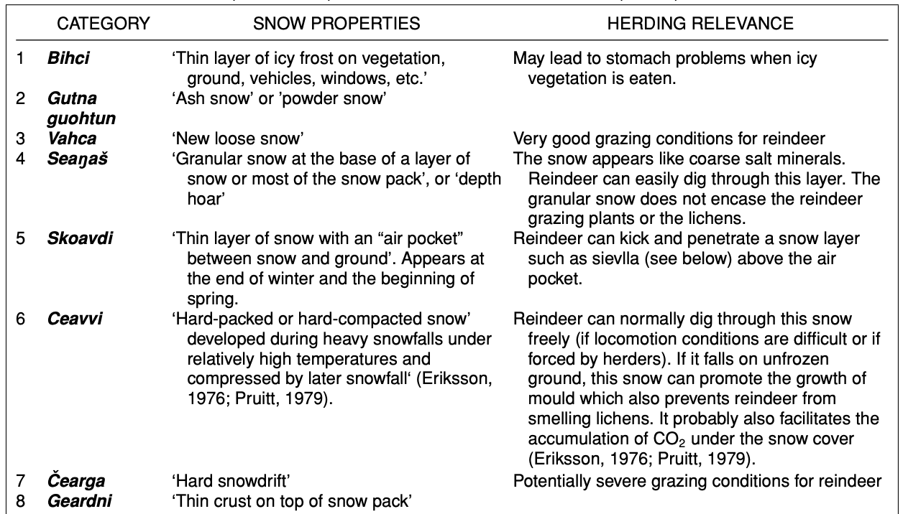
Indigenous perspectives improve glaciology
Example: The Sámi people are indigenous to parts of Norway, Finland, and Sweden. Snow density, hardness and depth are important factors in reindeer herd management. Sámi people describe many snow types with distinct material properties and observe climate induced environmental changes that may go unnoticed by scientists.¹ Sámi people and their observations provide valuable information that improves understanding of ice and snow dynamics and benefits local communities.
Indigenous peoples have made observations of glaciers, glacial landforms, glacial hydrology, and snow for hundreds of years.
Subset of snow categories described by Sami people¹
Notes:
¹Sámi traditional ecological knowledge as a guide to science: Snow, ice and reindeer pasture facing climate change (Riseth et al 2011)

Slide 7
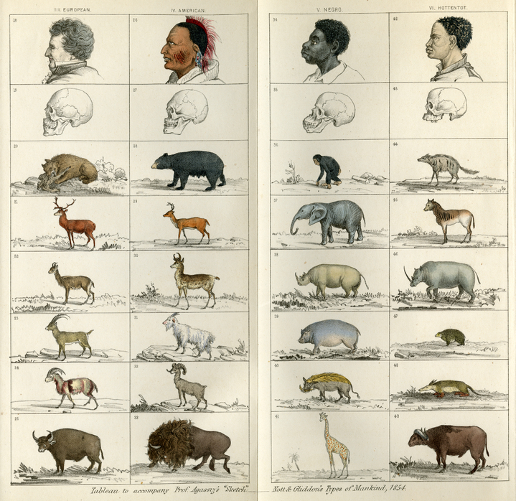
Glaciology and Race: Louis Agassiz
Louis Agassiz was a scientific racist and a key figure in early glaciology: In 1837, Louis Agassiz presented the idea of oscillatory ice ages to Helvetic Natural History Society. He moved to the US in 1846 to give a lecture series (“The Plan of Creation as shown in the Animal Kingdom”), and in 1847 Agassiz was hired as the head of Harvard’s new Lawrence Scientific School (later SEAS) as its first attempt to provide a formal education in science and engineering. In 1859, Agassiz founded the Harvard Museum of Comparative Zoology, which he directed until his death in 1873.¹
Agassiz was a proponent of polygenism, the idea that different races constitute different species: “The production of half-breeds is as much a sin against nature, as incest in a civilized community is a sin against purity of character. . . .No efforts should be spared to check that which is abhorrent to our better nature, and to the progress of a higher civilization and a purer morality.” - Agassiz to his mother in 1846.²
Agassiz passed on his legacy of racism: Nathaniel Shaler, an outspoken white supremacist who was eventually hired by Harvard, was one of Agassiz’s students. Shaler mentored William Morris, an eventual Harvard geographer who justified racial classification based on perceived contributions to civilization. Morris mentored Ellsworth Huntington, a scientist who was an early supporter of the idea that Earth’s climate undergoes major variations. He used this work to validate the role of a “stimulating climate” in the development of civilization. Agassiz’s style of scientific racism was perpetuated and normalized at respected universities in the United States by his academic family tree.
Different species of animals displayed with various human skulls, drawn by Louis Agassiz in Types of Mankind (1854)³
Notes:
¹https://en.wikipedia.org/wiki/Louis_Agassiz
²The Roots of the I.Q. Debate: Eugenics and Social Control (Quigley 1995)
³https://scalar.usc.edu/works/measuring-prejudice/one-race-or-several-species

Slide 8
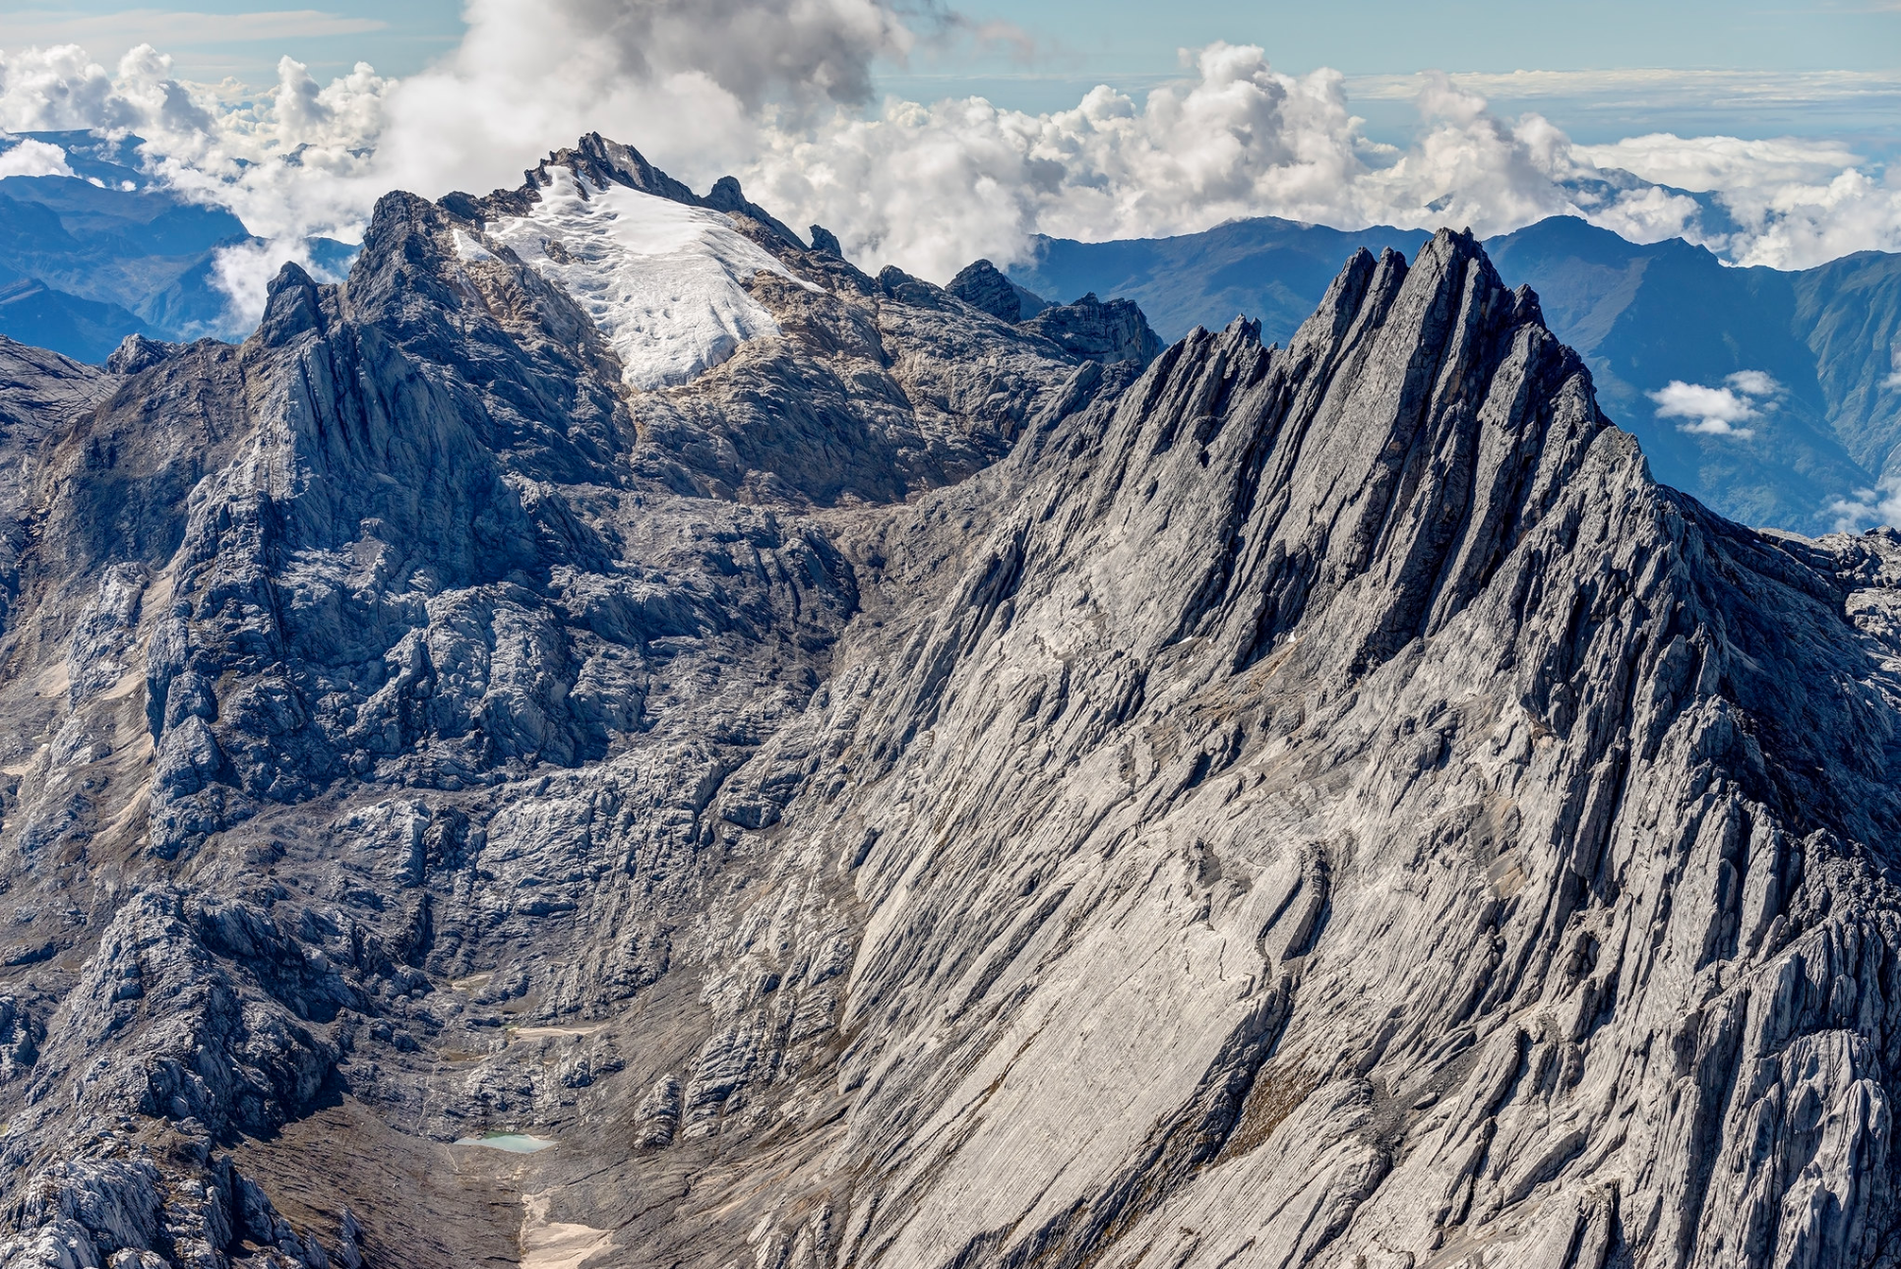
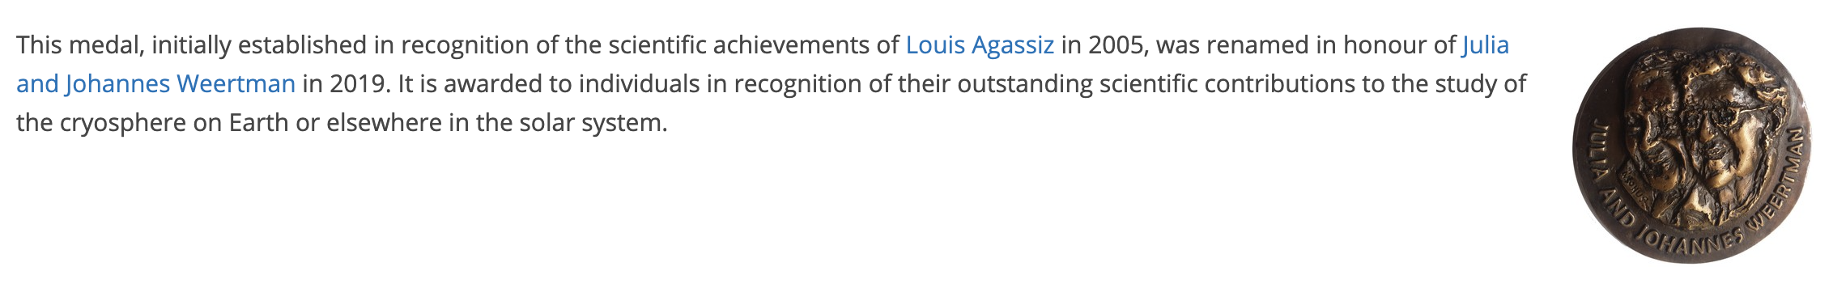
Naming of Glaciers and Landforms
Carstenz glacier: The region surrounding this vulnerable tropical glacier in Indonesia is home to the Amung indigenous people, yet the glacier is named after Dutch East India Company explorer Jan Carstenz, who “discovered” it in 1623. On his various journeys, Carstenz attempted to kidnap indigenous people and described indigenous Australians as “poor and miserable looking people… [with] no knowledge of precious metals or spices”.¹
Louis Agassiz: Many things bear Agassiz’s name across the US and world. These include Agassiz Glacier in Montana, the EGU Louis Agassiz Award (renamed in 2019), Agassiz National Wildlife Reserve in Minnesota, Lake Agassiz, a huge lake formed during the last Ice Age, two mountains in California named Mount Agassiz, and more.
Geographic locations relevant to glaciology are often named after people with a legacy of racism and imperialism. Renaming may be a way to stop perpetuating the legacy of racists, though care must be taken to avoid masking information about racism in geosciences.
Carstenz Glacier, Indonesia²
EGU on the renaming of the Louis Agassiz Award. The updated Julia and Johannes Weertman award is shown to the right.³
Notes:
¹https://www.kb.nl/sites/default/files/docs/carstens-translation.pdf
²https://www.flickr.com/photos/46179870@N04/14122786124
³https://www.egu.eu/awards-medals/julia-and-johannes-weertman/

